Slide 1
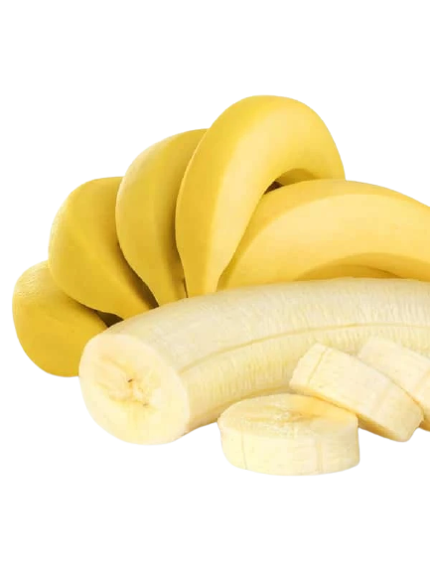
Fruit2U Banana Dehydrator
Team Members:
Ash Thomas
Aaron Seemungal
David Sehrt
Kwasi Darkwah

Slide 2
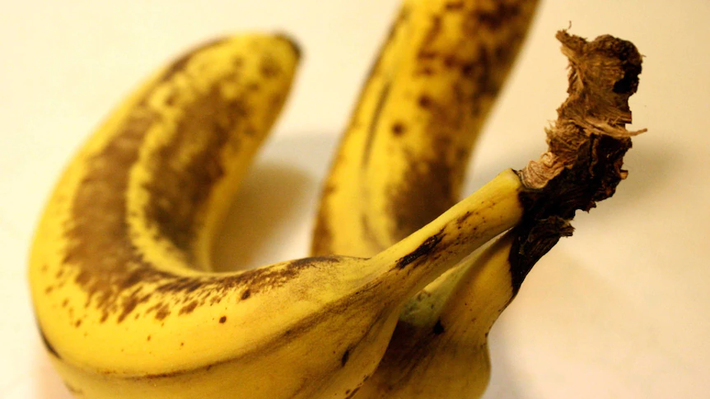

Agenda
1.
Background
7.
Concept Exploration
2.
Problem Statement & Solution
8.
Analysis
3.
Requirements
9.
WBS
4.
Use Case Model
10.
Cost Estimation
5.
System and Requirements Validation & Verification
11.
Conclusion
6.
Functional Architecture

Slide 3
Background
Need
Food Wastage
Distribution Challenges
Global Hunger
Global Warming
Food Shortage

Slide 4
Background
Need
Food Wastage
Distribution Challenges
Global Hunger
Global Warming
Food Shortage

Slide 5
Problem Statement and Solution
Food Wastage
Retail Groceries
Produce
Bananas
Problem Statement
Short spoilage time and perishability lead to bananas being major contributors to produce waste [1].
Solution
Develop an equipment to prepare, dehydrate and package surplus bananas for transport to food banks.
Goal: Reduces landfill and provides food to the hungry.

Slide 6
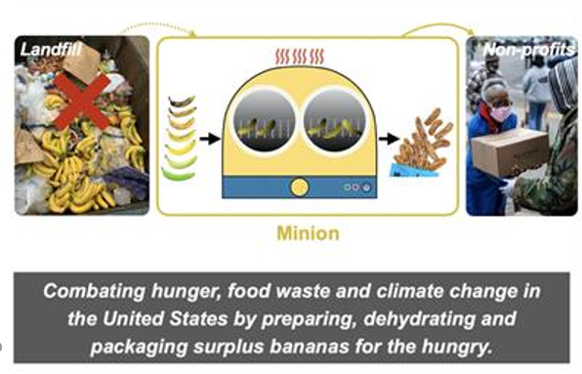
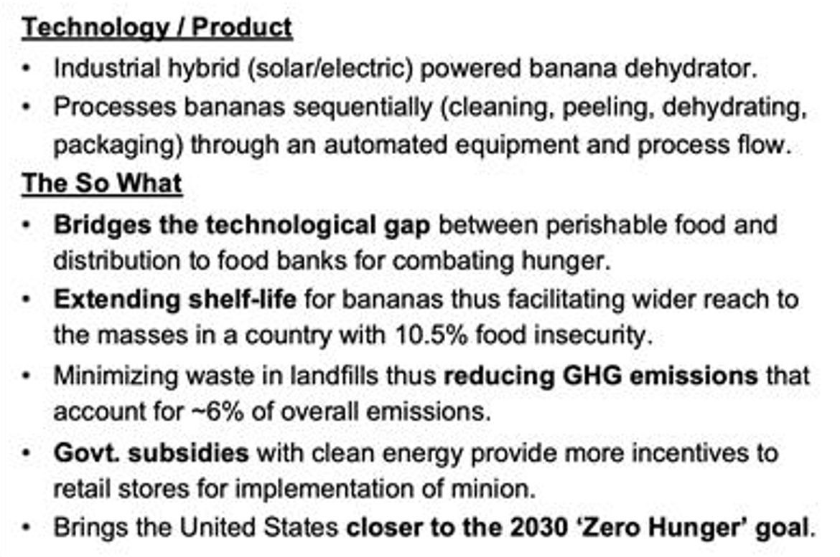
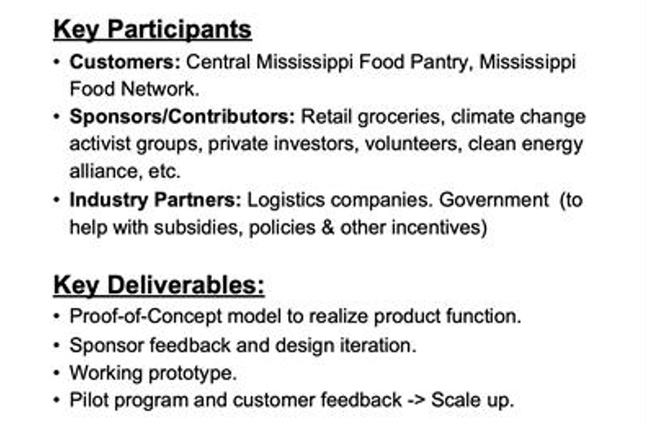
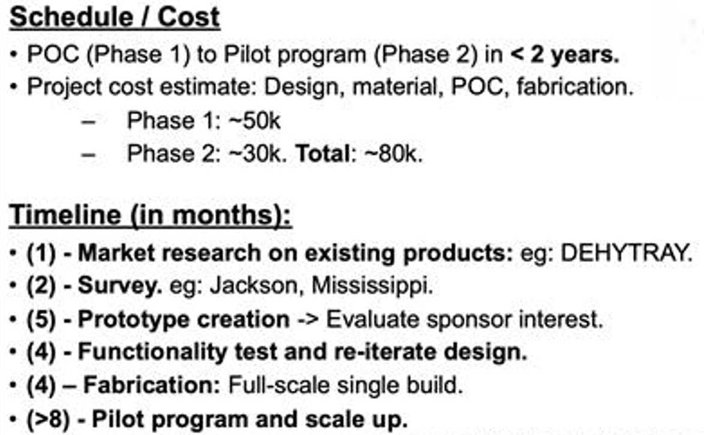
Preliminary Concept

Slide 7

Context Diagram
NSH
Logistics Companies
Grocery stores provide infrastructure and bananas.
Store Employees are operators.
Food banks
Regulatory bodies
Fruit2U
NSH
Food Banks benefit from output of Fruit2U System.
Retail Grocery
(Customer)
Store Employee (EQ User)
Maintenance / Sanitation team
Notes:
Customer VS user

Slide 8
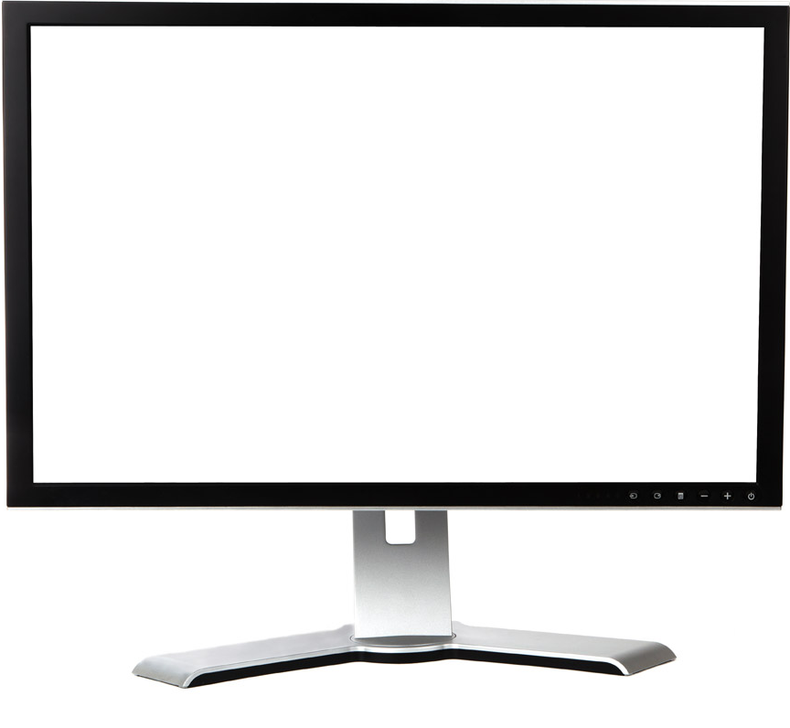
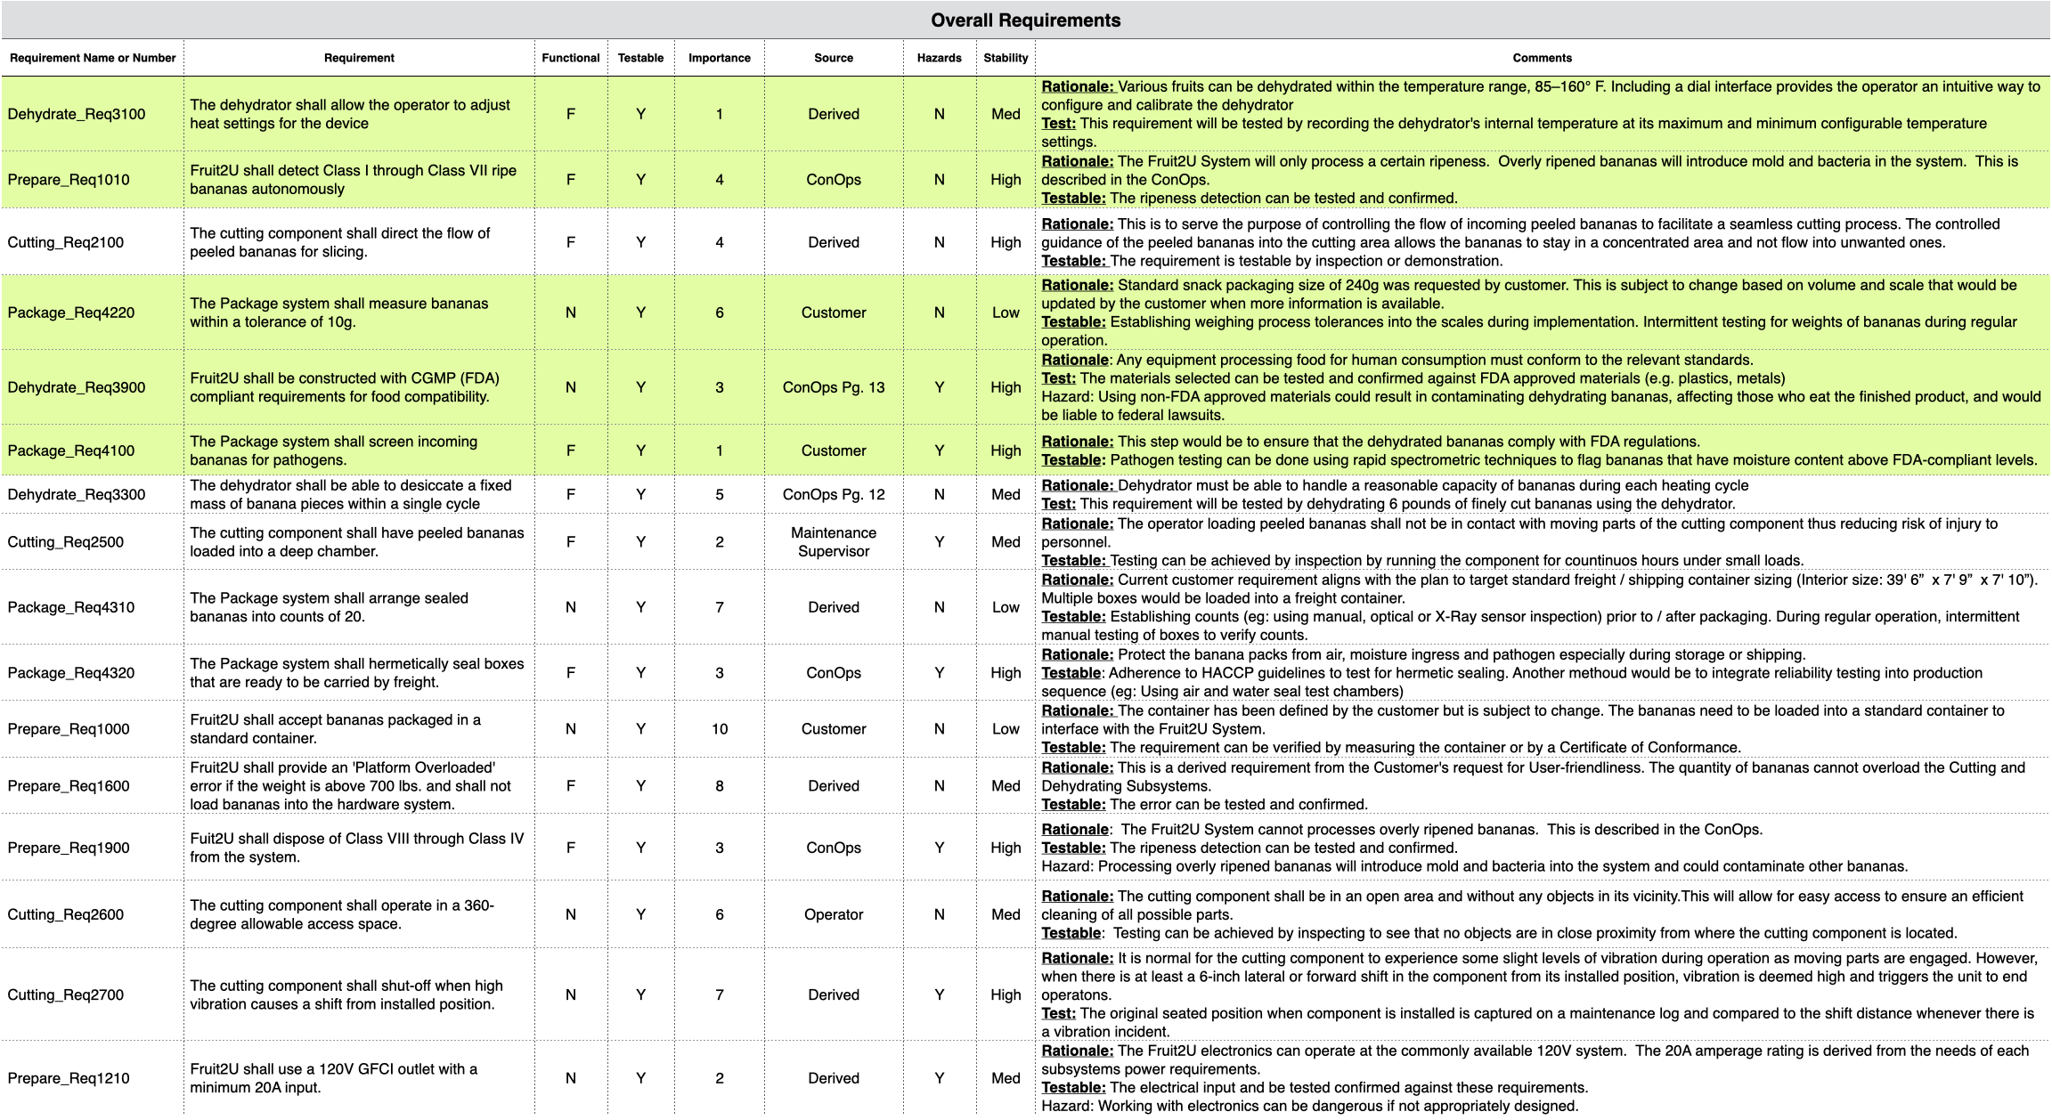
Requirements
Customer Requirements
The Fruit2U shall detect Class I through Class VII ripe bananas autonomously
The cutting component shall direct the flow of peeled bananas for slicing
The dehydrator shall be able to desiccate a fixed mass of banana pieces within a single cycle
The equipment shall be constructed using materials that meet regulatory requirements for food compatibility
The Package system shall screen incoming bananas for pathogens
Derived requirements

Slide 9
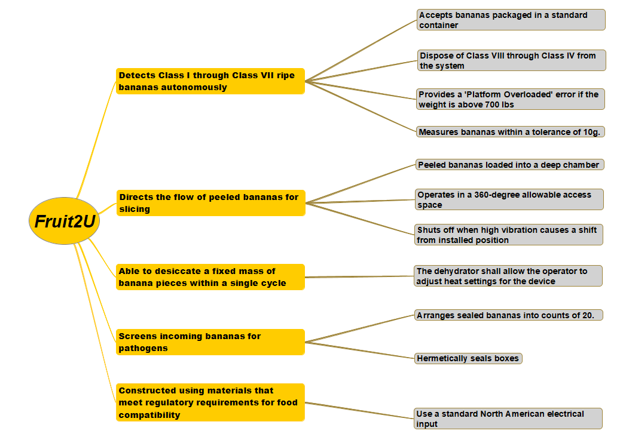
Requirements
Customer Requirements
Requirements were captured from the Customer. (e.g. RFQ, interviews)
ConOps helped refine Customer needs.
High level requirements were derived from Customer requirements.
Derived Requirements

Slide 10
Use Case Model
System Bounds: Fruit2U is the equipment used to dehydrate bananas. It is not the dehydrated bananas.
Grocery Store employees will interface with Fruit2U to produced dehydrated bananas.
Inspectors will need occasional access to the Fruit2U to ensure food safety is met.
Logistic companies receive the output of the Fruit2U (dehydrated bananas) who pass the product to Food banks.
Fruit2U System
Inspection
Authority
Logistics Operators
1. Prepare
5. Inspect
2. Cut
Grocery Store Employee
Retail Groceries
/
3. Dehydrate
4. Package
System Boundary
Food Bank
Key
In
Out
External interaction
Internal interaction

Slide 11
Agenda
1.
Background
7.
Concept Exploration
2.
Problem Statement & Solution
8.
Analysis
3.
Requirements
9.
WBS
4.
Use Case Model
10.
Cost Estimation
5.
System and Requirements Validation & Verification
11.
Conclusion
6.
Functional Architecture

Slide 12
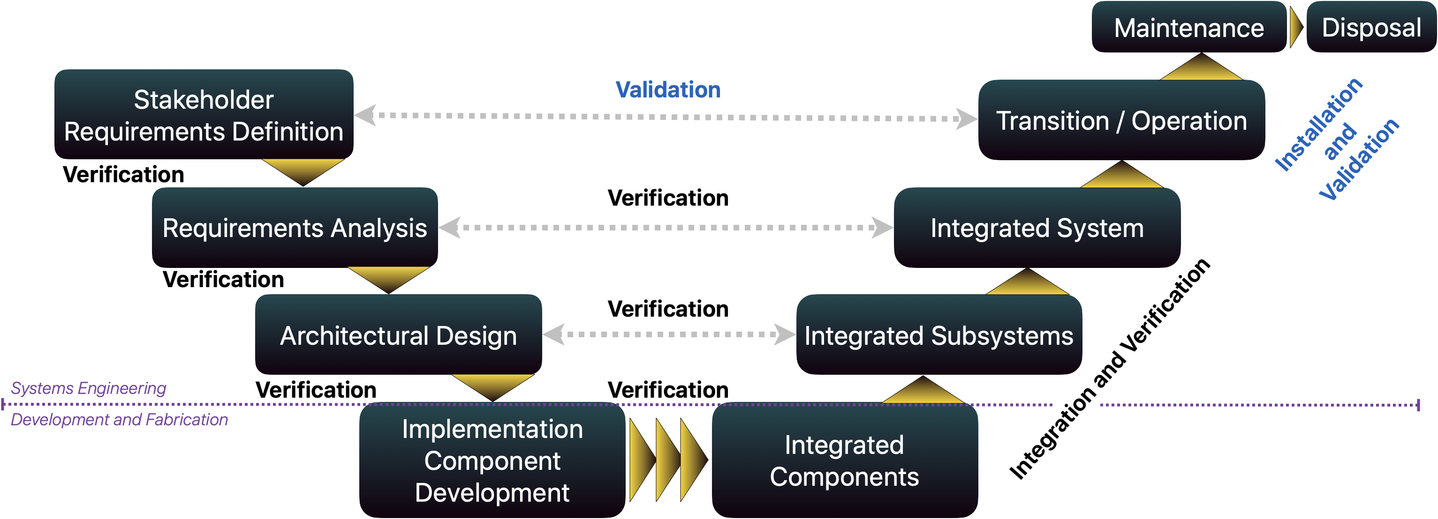
System Validation & Verification
Adapted from INCOSE diagram

Slide 13
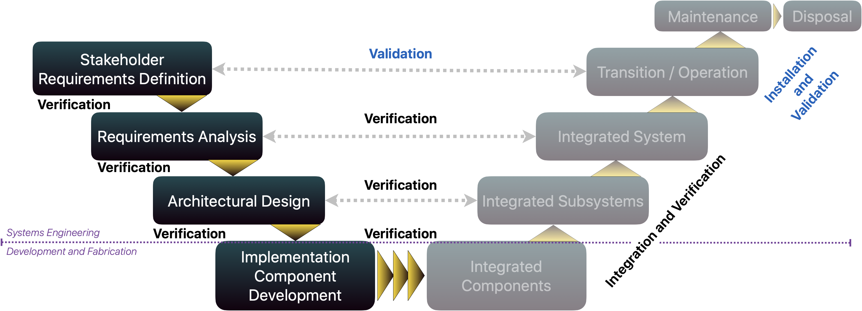
System Validation & Verification
Requirements | Verification Method
Detect Class I through Class VII ripe bananas autonomously. | T- Simulation and testing of detection function
Direct the flow of peeled bananas for slicing. | D- Demonstration of transfer lines
The dehydrator shall be able to desiccate a fixed mass of banana pieces within a single cycle. | A- Analysis of heat chamber and volumes. T- Prototype testing.
The equipment shall be constructed using materials that meet regulatory requirements for food compatibility. | I- Inspection and qualification of components used in equipment.
The Package system shall screen incoming bananas for pathogens. | T- Simulation and testing of microbe detection capability.
Baseline Verification
– Are we building it right?
Baseline Validation
– Are we building the right thing?
T Test | I Inspection | D Demonstration | A Analysis
Adapted from INCOSE diagram

Slide 14
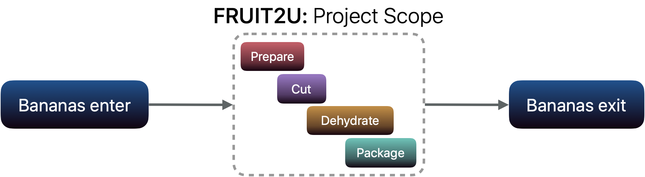
Functional Architecture

Slide 15
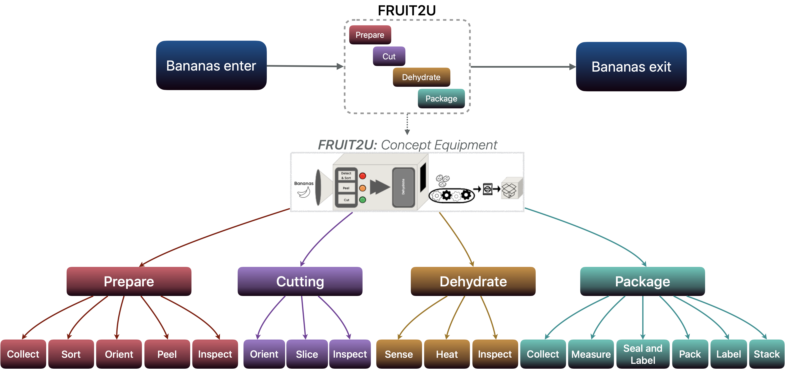
Functional Architecture – Tree Diagram

Slide 16
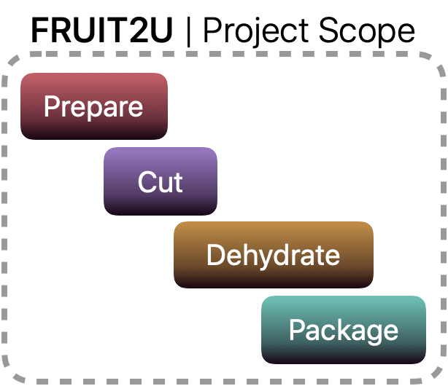
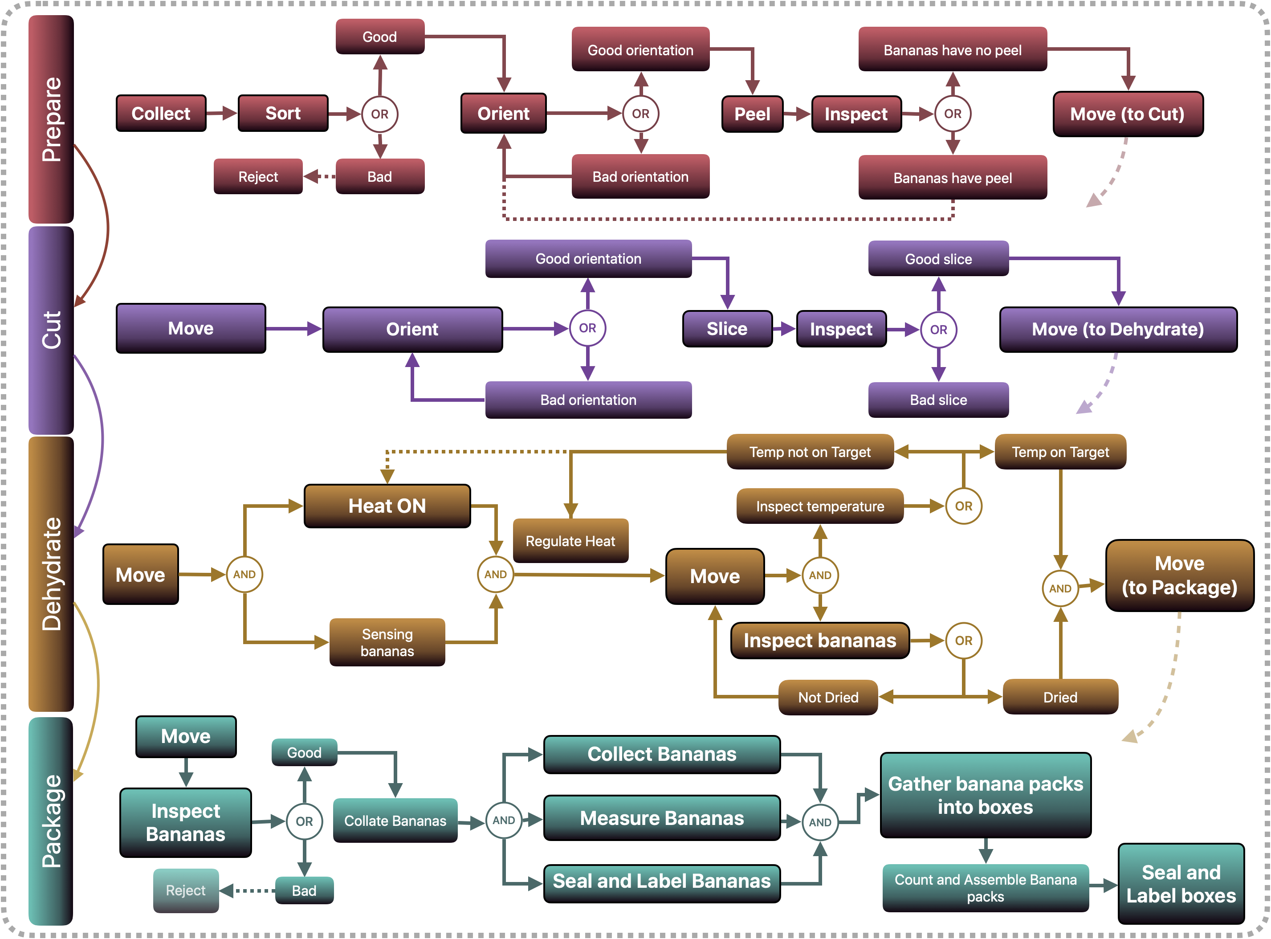
Functional Flow Block Diagram
Bananas Enter
Bananas Exit

Slide 17
Concept Exploration
Prepare
Manual Sorting
Vision System
Chemical
X-Ray
Cut
Cutting edge- blade, saw Blade
Waterjet
Laser
Wire
Dehydrate
Electric dehydrators
Conventional Oven
Microwave Oven
Solar Oven
Package
Aseptic Packaging
Cans
Bottles
Vacuum Bags
Technology Market Survey
Inspection​
Batch Inspection​
Manual Inspection​
CCD cameras
X-Ray Inspection​

Slide 18
Concept Exploration
Illustrative (subsystem) example
CUT
Characteristic Alternatives | Cutting edge - Blade, saw | Waterjet | Laser | Wire
Cost | 9 | 4 | 3 | 7
Reliability | 8 | 5 | 3 | 7
Maintainability | 8 | 5 | 4 | 7
Longevity | 8 | 4 | 3 | 7
Energy efficiency | 8 | 4 | 3 | 5
Slice Speed | 8 | 8 | 9 | 5
TRL | 9 | 7 | 2 | 6
Explored potential technologies for each function based on customer need/requirements
Combined identified technologies in morphological matrix
Exploration of TRLs included (TRL used NASA standards)

Slide 19
Agenda
1.
Background
7.
Concept Exploration
2.
Problem Statement & Solution
8.
Analysis
3.
Requirements
9.
WBS
4.
Use Case Model
10.
Cost Estimation
5.
System and Requirements Validation & Verification
11.
Conclusion
6.
Functional Architecture

Slide 20
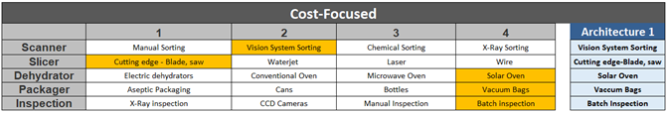
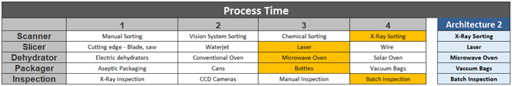
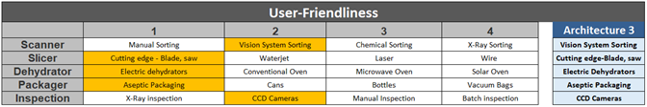
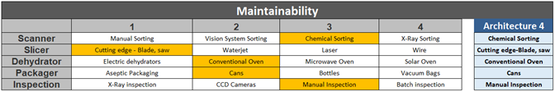
Morphological Matrix
Architecture 1 | Architecture 2 | Architecture 3 | Architecture 4
Cost-Focused | Process Time | User-Friendliness | Maintainability
Vision System Sorting | X-Ray Sorting | Vision System Sorting | Chemical Sorting
Cutting edge-Blade, saw | Laser | Cutting edge-Blade, saw | Cutting edge-Blade, saw
Solar Oven | Microwave Oven | Electric Dehydrators | Conventional Oven
Vaccuum Bags | Vaccuum Bags | Aseptic Packaging | Cans
Batch Inspection | Batch Inspection | CCD Cameras | Manual Inspection
Morphological Matrix fed into system architectures.
Each Architecture was verified for compatibility of technologies.

Slide 21


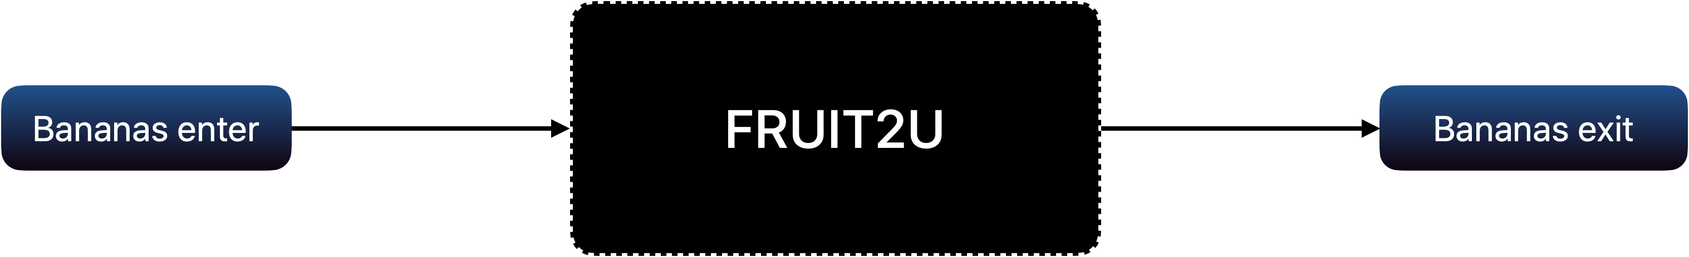
Design Model
Which architecture to down select?
Architecture 1 | Architecture 2 | Architecture 3 | Architecture 4
Cost-Focused | Process Time | User-Friendliness | Maintainability
Vision System Sorting | X-Ray Sorting | Vision System Sorting | Chemical Sorting
Cutting edge-Blade, saw | Laser | Cutting edge-Blade, saw | Cutting edge-Blade, saw
Solar Oven | Microwave Oven | Electric Dehydrators | Conventional Oven
Vaccuum Bags | Vaccuum Bags | Aseptic Packaging | Cans
Batch Inspection | Batch Inspection | CCD Cameras | Manual Inspection

Slide 22
Design Model-Analysis
Criteria | DATUM | Architecture 1 | Architecture 2 | Architecture 3 | Architecture 4
Cost | 3 | + | - | - | +
Energy Efficiency | 3 | + | - | + | S
Reliability | 7 | S |  | + | -
Maintainability | 5 | + | - | + | +
Durability | 7 | S | - | S | S
Performance | 6 | - | + | + | -
TRL | 9 | S | - | - | +
Process Stability | 4 | - | + | - | S
Food Safety | 8 | - | + | + | -
Capacity | 8 | - | S | + | -
Seal Quality / Ingress | 9 | S | S | - | -
Ease of Implementation | 6 | + | - | S | +
Sum of Postives |  | 4 | 4 | 6 | 4
Sum of Negatives |  | 4 | 6 | 4 | 5
Sum of Sames |  | 4 | 2 | 2 | 3
Weighted Sum of Positives |  | 17 | 25 | 37 | 23
Weighted Sum of Negatives |  | 26 | 33 | 25 | 38
Overall Score: |  | -9 | -8 | 12 | -15
PUGH Matrix Legend
S | Standard
+ | Better than
- | Less than
First pass-evaluation / preliminary analysis
Equal weighting across Criteria
Pugh recommends A3: User Friendliness Architecture
Drawbacks:
The Pugh Matrix provided a general (unsatisfactory) result. Did not provide confidence in a decision.

Slide 23
Prioritization Matrix
KEY | 0.1 Extremely less important | 0.2 Significantly less important | 1 Equally important | 5 Significantly more important | 10 Extremely more important
Prioritization Matrix helps generate weights for TOPSIS Analysis.
Criteria relative importance | Safety | User Friendly | Process Time | Maintainability | Total across rows | % of Grand Total
Safety |  | 1.00 | 1.00 | 5.00 | 7.00 | 0.32
User Friendly | 1.00 |  | 0.20 | 1.00 | 2.20 | 0.10
Process Time | 1.00 | 5.00 |  | 5.00 | 11.00 | 0.51
Maintainability | 0.20 | 1.00 | 0.20 |  | 1.40 | 0.06
Column Total | 2.20 | 7.00 | 1.40 | 11.00 | 21.60 | 1.00

Slide 24
TOPSIS
TOPSIS was performed for more quantitative evaluation
Prioritization Matrix informed weights, but not for all TOPSIS criteria
Cost was considered most important criterium
TOPSIS and PUGH results diverged; TOPSIS recommends A1: Cost-Focused.
Quantitative metrics | Weight | Cost Focused | Process Time | User-Friendliness | Maintainability
Product Cost ($) | 30% | $7,000 | $20,000 | $15,000 | $12,000
Processing Time (hrs) | 20% | 7 | 3 | 6 | 9
Food Safety Rating (1-10) | 12.5% | 8 | 10 | 9 | 8
Power Consumption (kW-hrs) | 10% | 5.2 | 11.8 | 6.2 | 9.2
Ease of Implementation Rating (1-10) | 10% | 2 | 5 | 9 | 6
Capacity (sq ft) | 7.5% | 45 | 50 | 64 | 40
Repair and Maintenance Rating (1-10) | 5% | 7 | 3 | 7 | 10
Reliability Rating (1-10) | 5% | 7 | 7 | 8 | 5
Closeness to Ideal |  | 0.627 | .392 | 0.510 | 0.482
Rank |  | 1 | 4 | 2 | 3

Slide 25
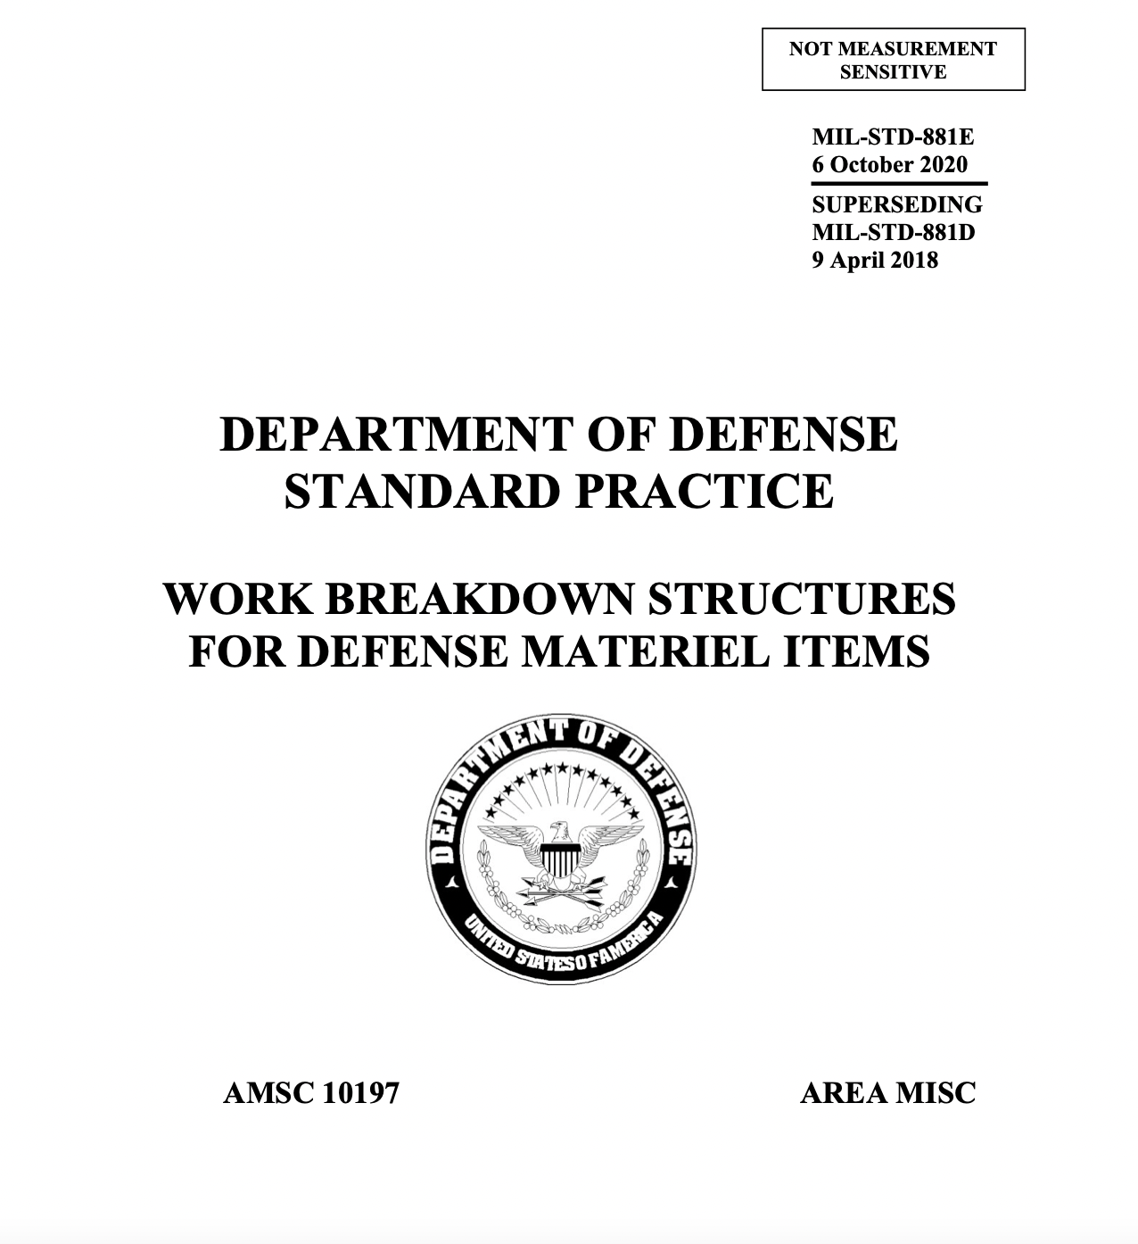
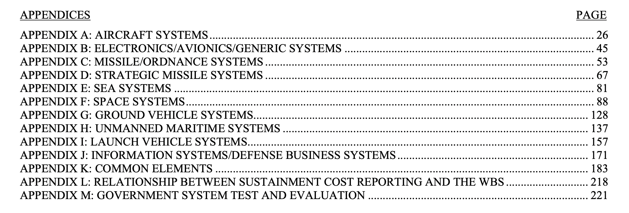
Work Breakdown Generation
WBS leveraged MIL-STD-881E (281-page standard!)
Appendix K- Common Elements most applicable to the Fruit2U System.
Section 3 explained 12 common elements
Tailored these Common elements to Fruit2U: Systems Engineering, Program/Project Management, Training, Facilities, Data Support, Standard Equipment, etc.

Slide 26
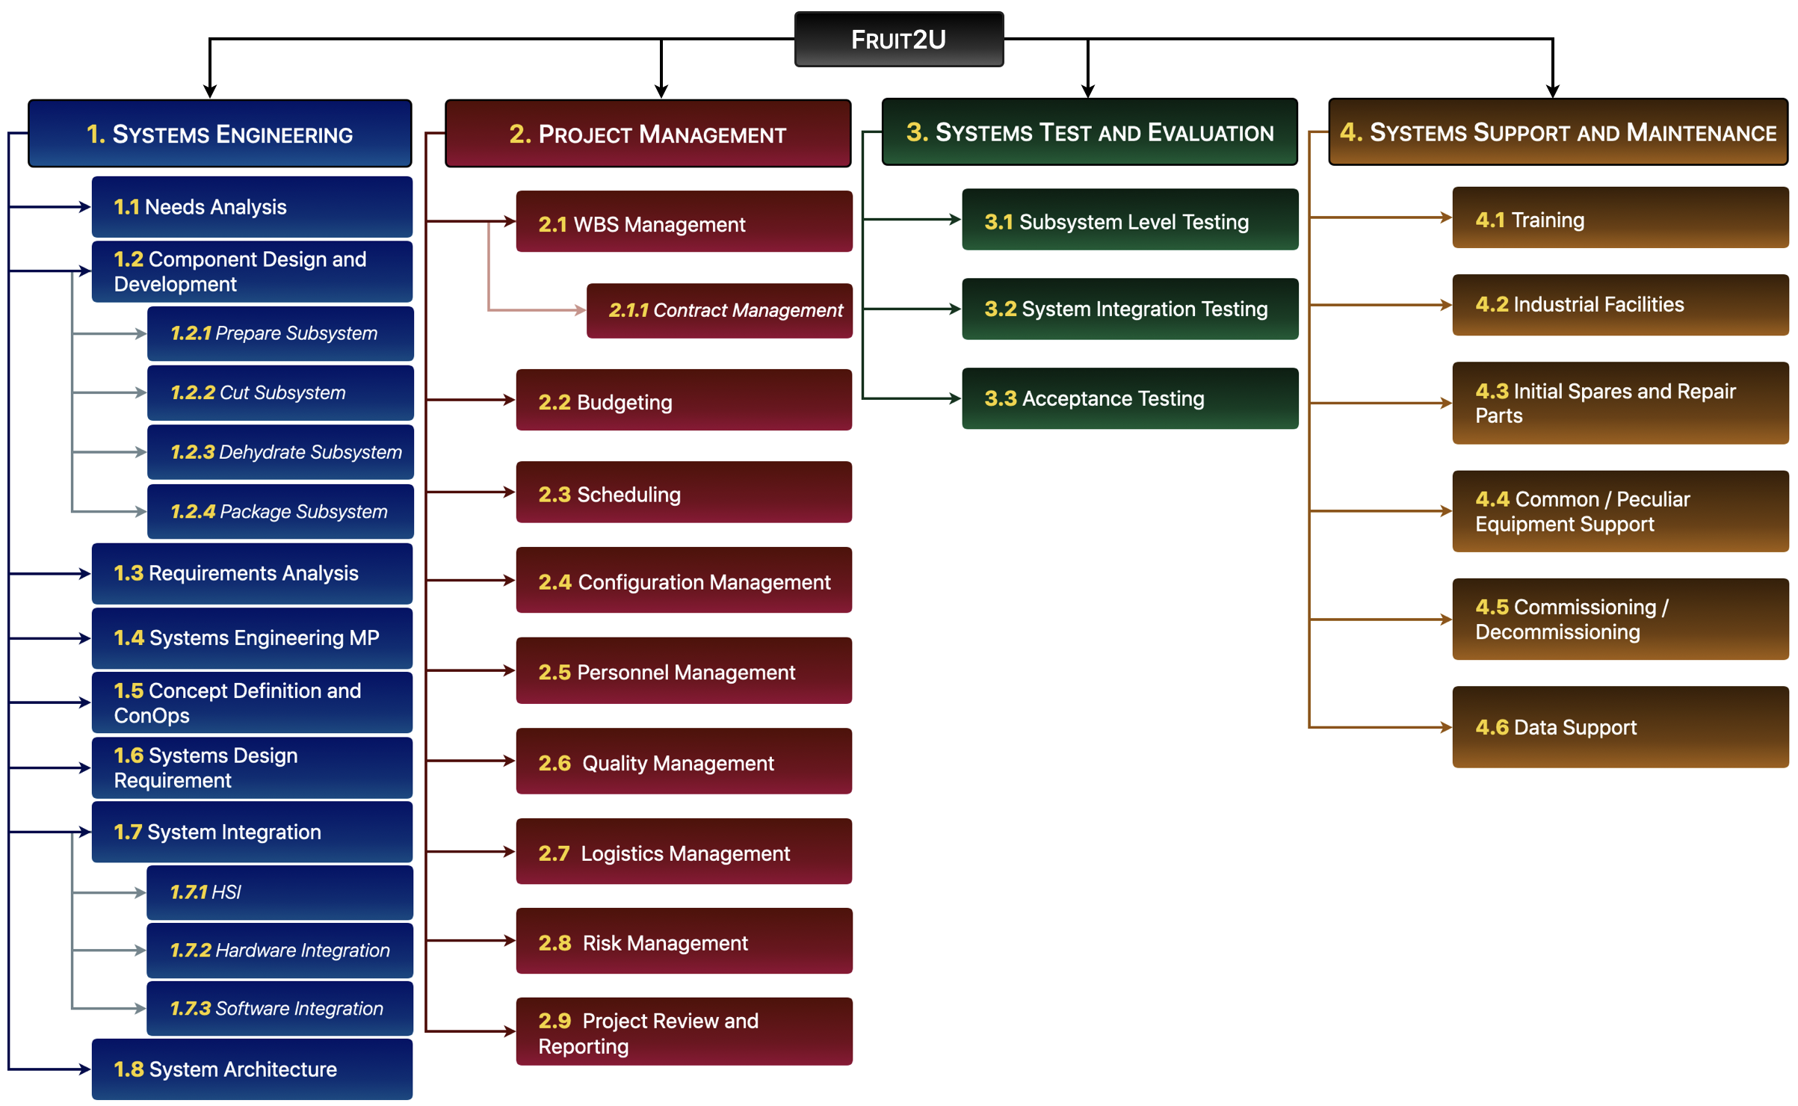
Work Breakdown Structure
*
*
*
*
*
*
*
*
*
*
*
*
*
*
*
*MIL-STD Appendix K Elements Captured in WBS.
Other Elements identified as important to Fruit2U.

Slide 27
Agenda
1.
Background
7.
Concept Exploration
2.
Problem Statement & Solution
8.
Analysis
3.
Requirements
9.
WBS
4.
Use Case Model
10.
Cost Estimation
5.
System and Requirements Validation & Verification
11.
Conclusion
6.
Functional Architecture

Slide 28
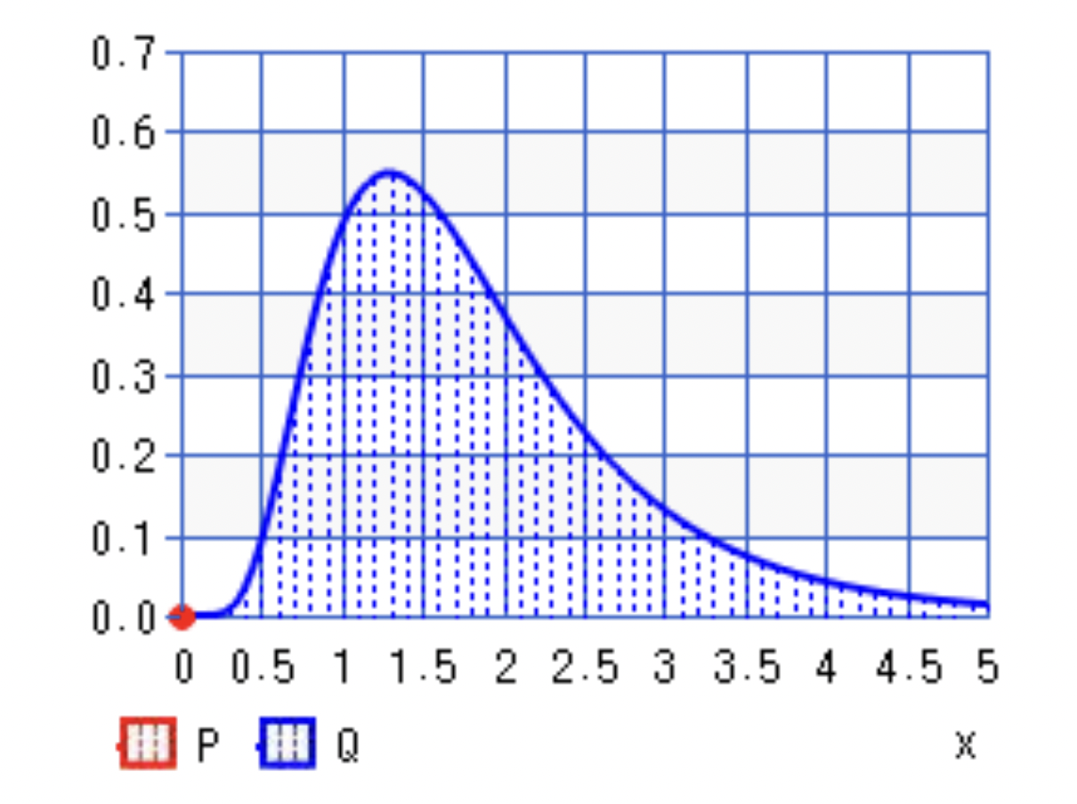
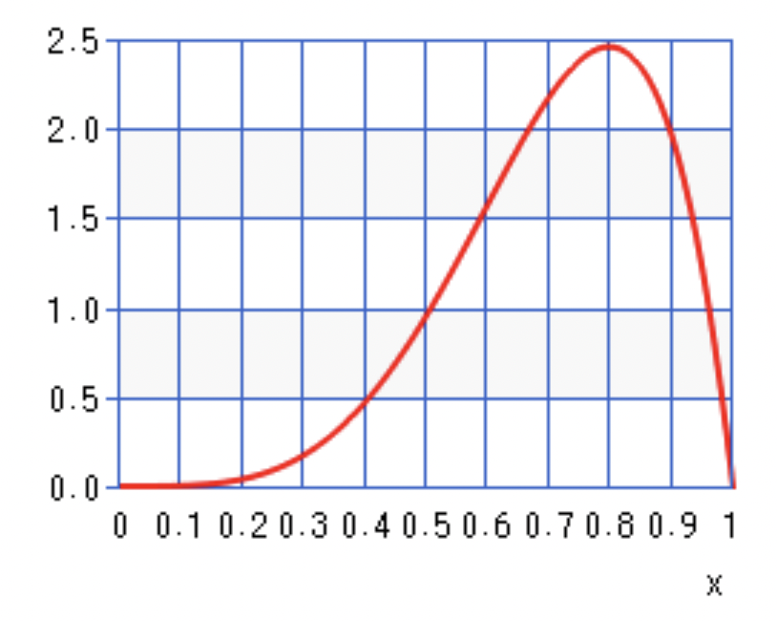
Cost Estimate: Bottoms-Up from WBS
WBS Work Packages allowed for an accurate estimation of project development costs.
Top-down, Analogous, and Expert Judgement were not feasible approaches.
Distributions were modeled as fixed, range, lognormal, and PERT-Beta
Distribution | Typical Application
Gaussian (normal) | Used when there is an equal chance of high/low occurrence.
Lognormal | Used when there is no better info is available.
PERT-Beta | Used when there is an Expert opinion available. It emphasizes the “most likely” value over the minimum and maximum estimates
Uniform | Used when the likelihood of outcomes is unknown or unclear. Useful in situations in which you have a minimum and maximum estimate available, but no other information
Fixed | Used when the value is unlikely to vary.
Lognormal is conservative with right shifted PDF.
Beta has a PDF influenced by expertise.
*PDF= Probability Distribution Function

Slide 29
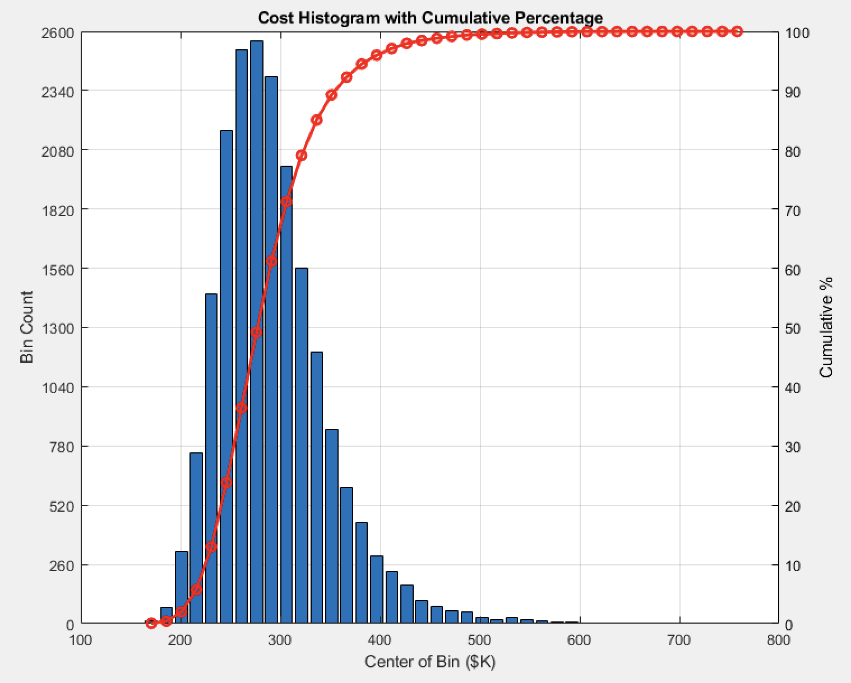
Cost Estimation
Proprietary GT PMASE Matlab code was altered for the Fruit2U System.
Systems Engineering required 14% of costs.
The 80% Cumulative Percentage (CDF) was $340K. (Range $165K-$765K)
Has elements of lognormal distribution (result of inexperienced conservative estimate with long tails)

Slide 30
Conclusions
System Evaluation and Path Forward
Fruit2U appears to be a viable solution to combat food waste and tackle systemic hunger.
The Fruit2U team successfully applied a Fundamental Systems Engineering development approach. System Verification and Validation is still needed.
ASE6002 and other future courses would be essential to further develop Fruit2U through a deeper understanding of Systems Design and Analysis.
MBSE may be employed for further insight into Fruit2U and decision-making.
Key Takeaway and Learnings
Difference between customer and system requirements.
Selection of the right tool for analyses.
Inhibit the excitement to jump straight into design.
There is an ideal balance between work put into quantitative analysis and the strength of the outputs for decision-making.
As always…systems is a team sport!

Slide 31
Questions?
Conclusion

Slide 32
Thank You!
Conclusion
Special thanks to Brian for his continued mentorship and guidance

